Slide 1
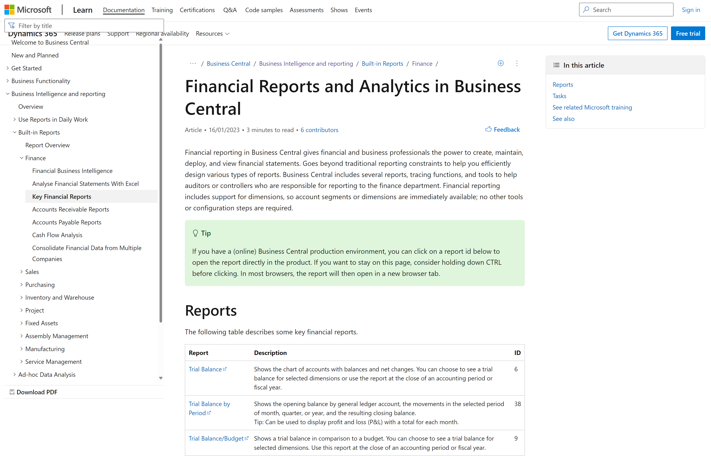
https://aka.ms/bcreporting

Slide 2
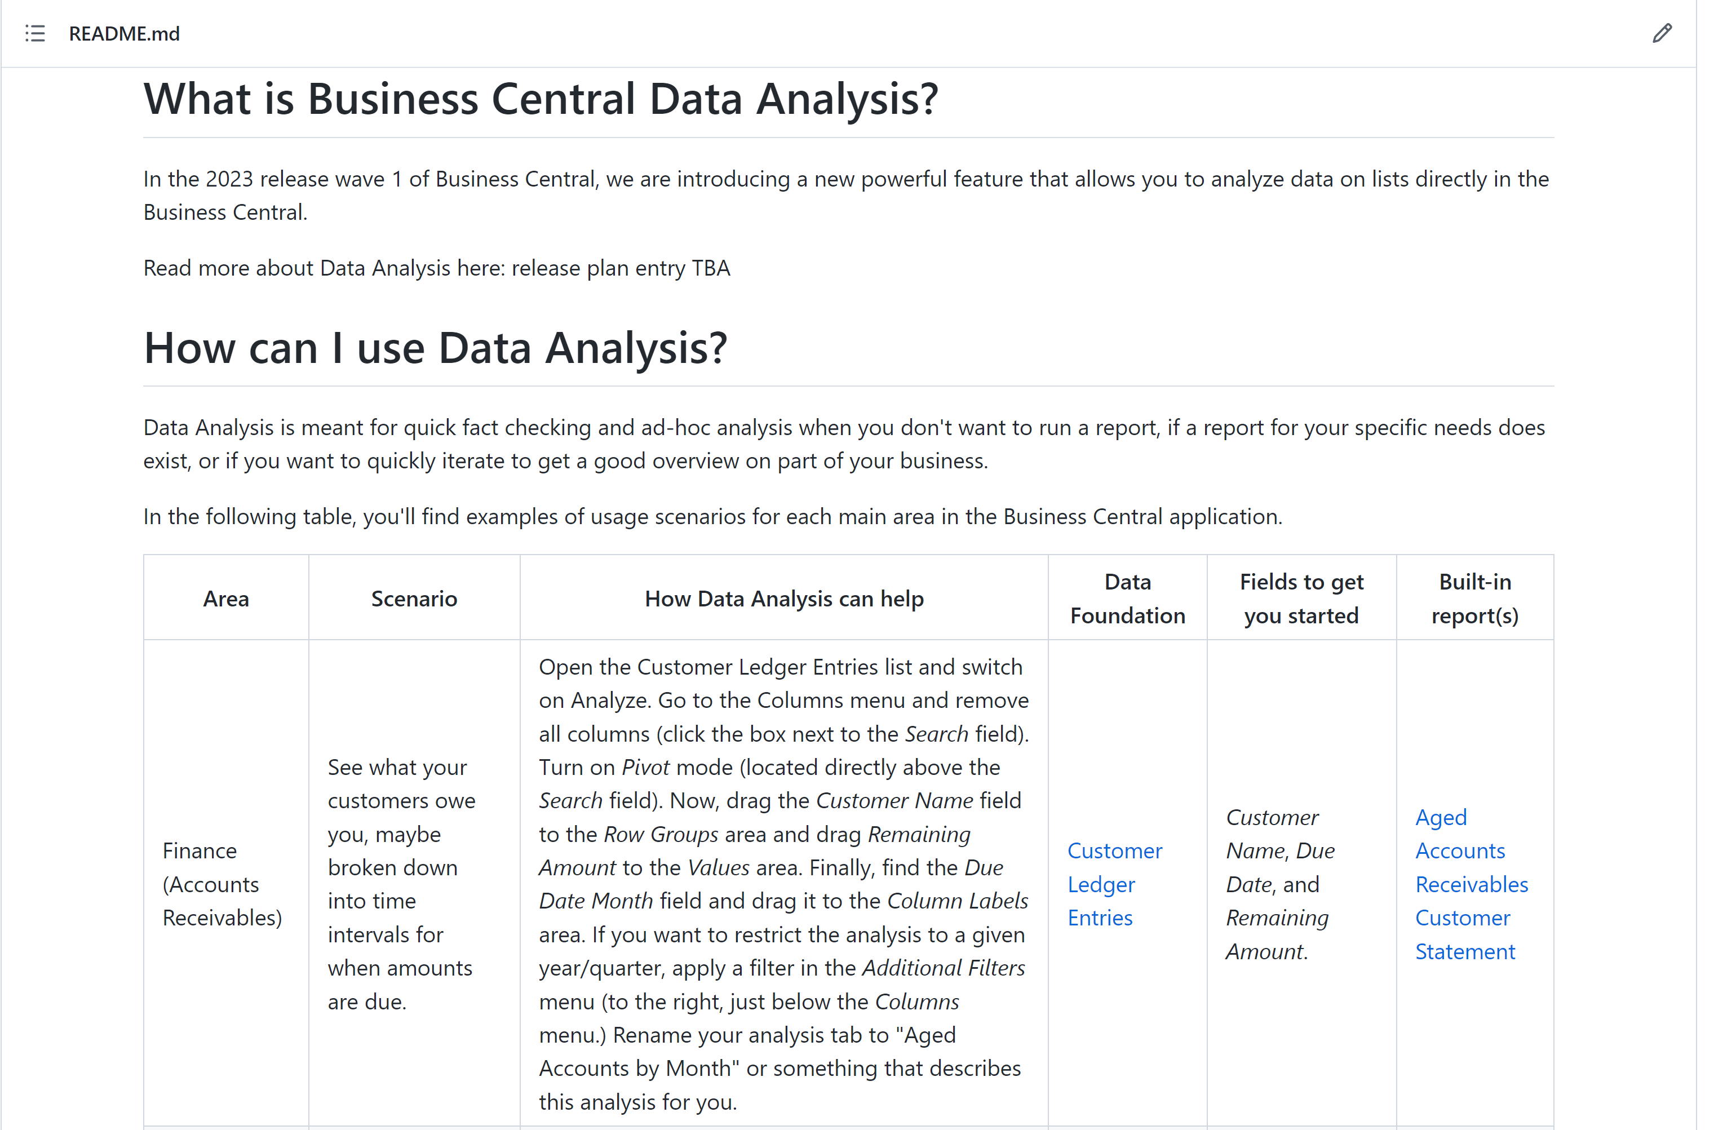
https://aka.ms/bcdataanalysis

Slide 3
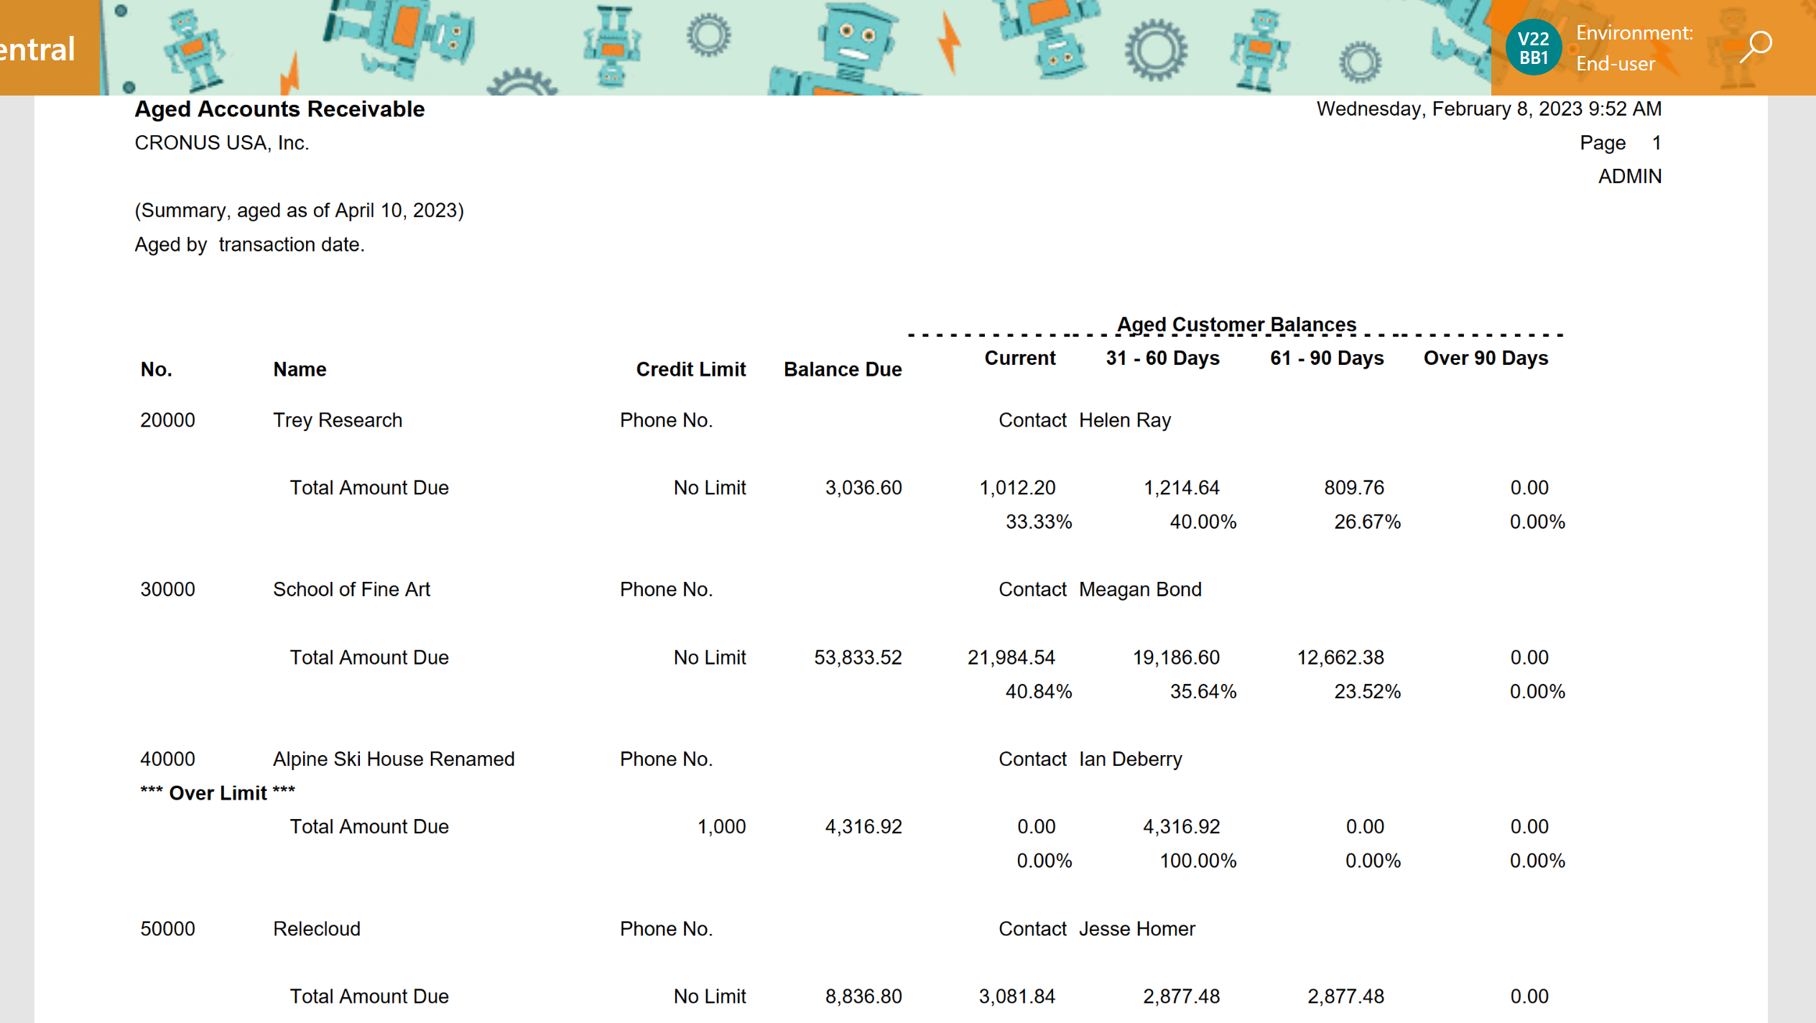
Before: run a report, get a pdf

Slide 4
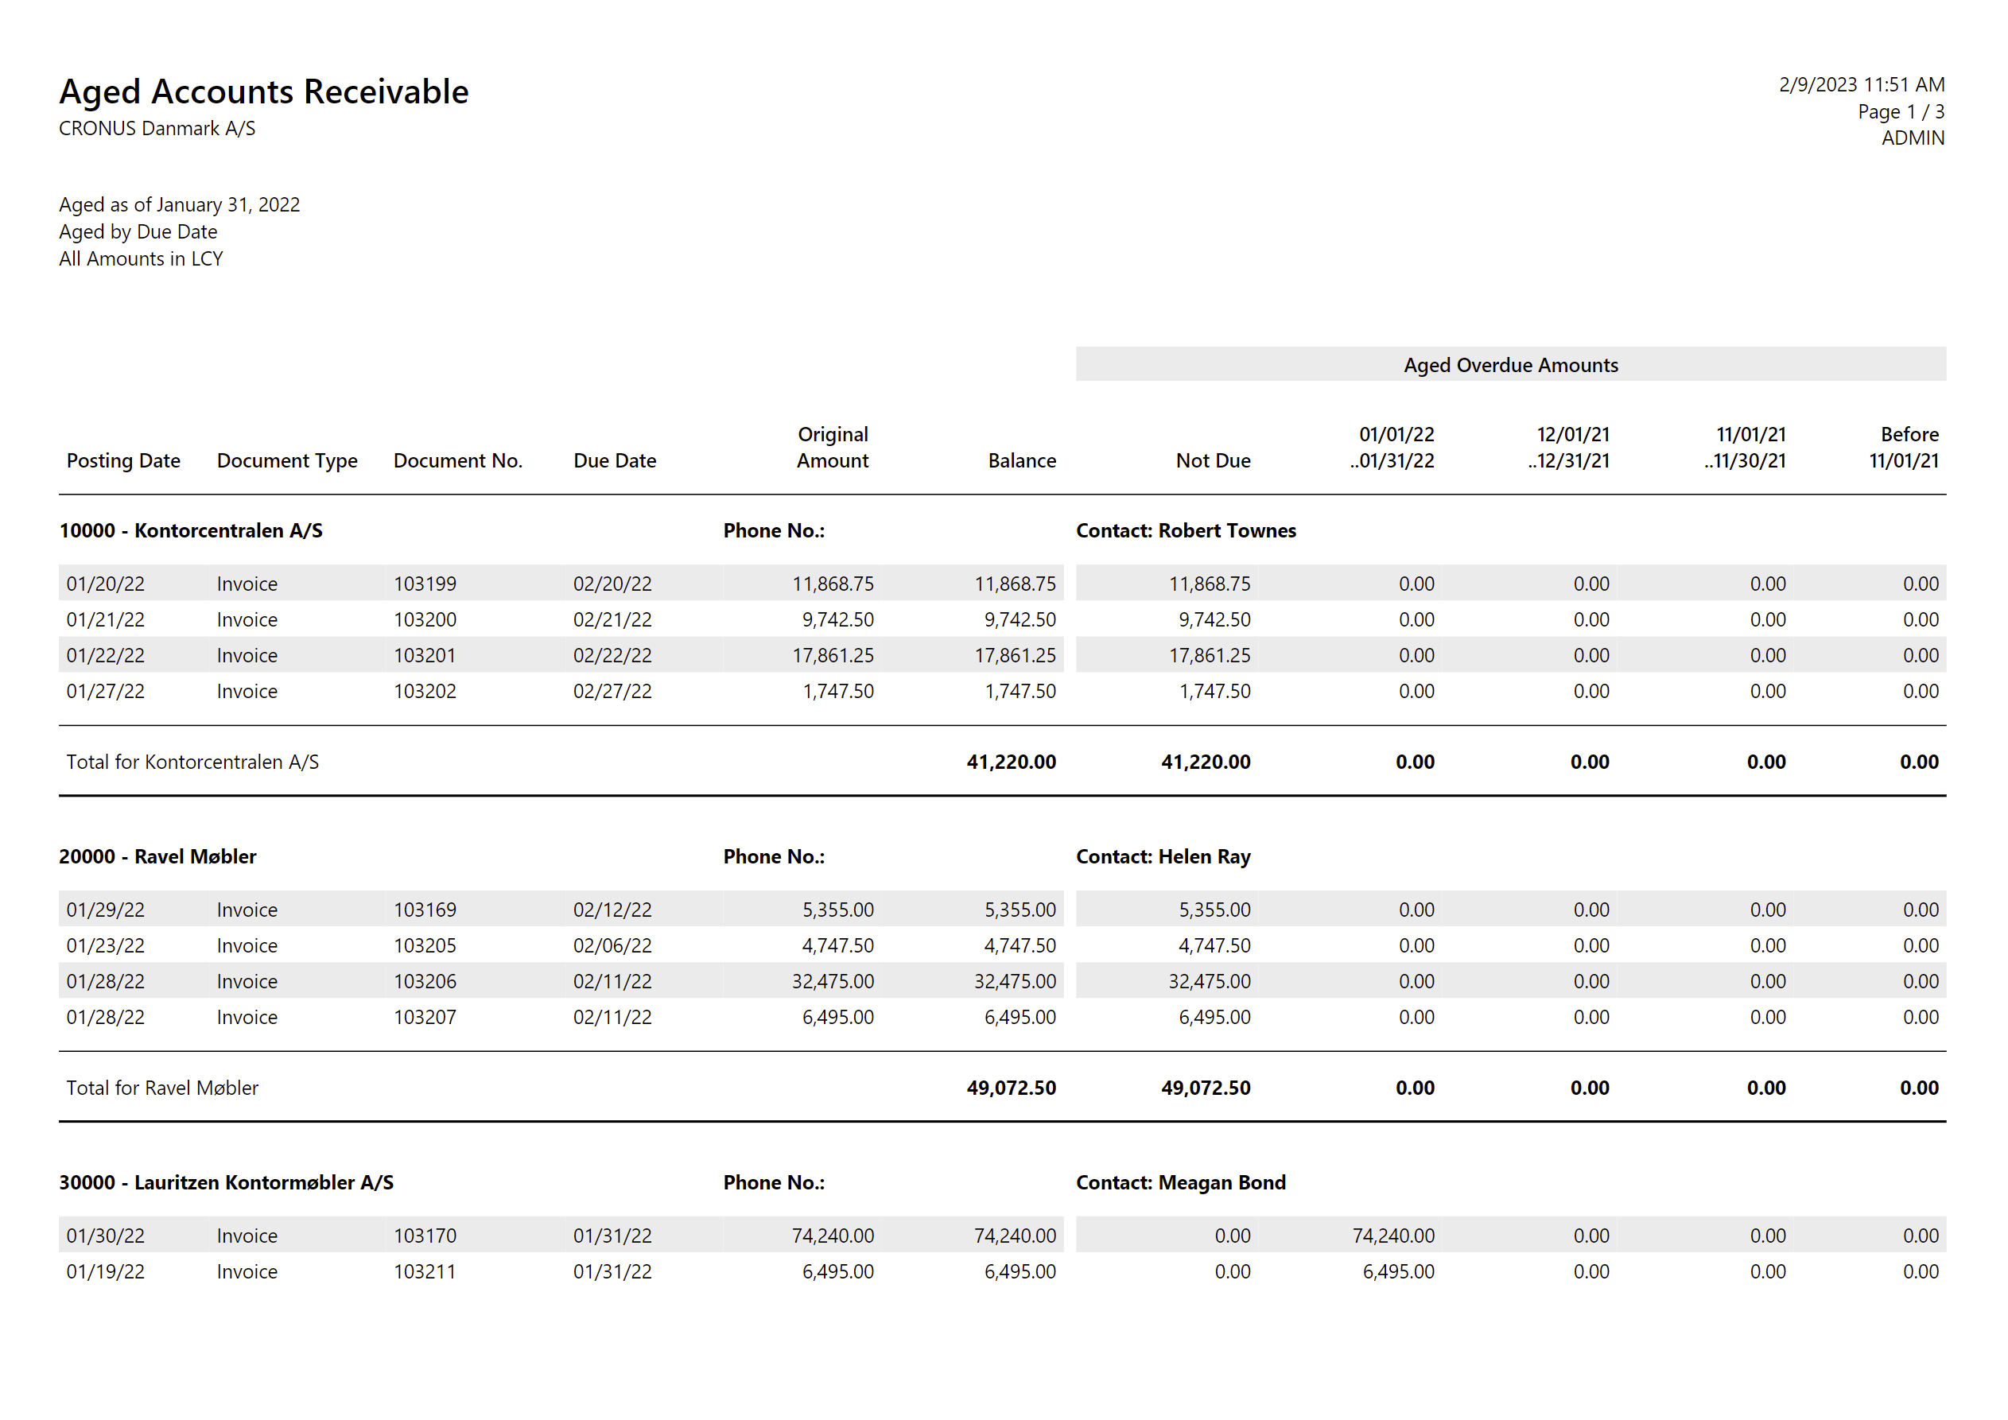
Before: run a report, get a pdf
W1 version ;o)

Slide 5
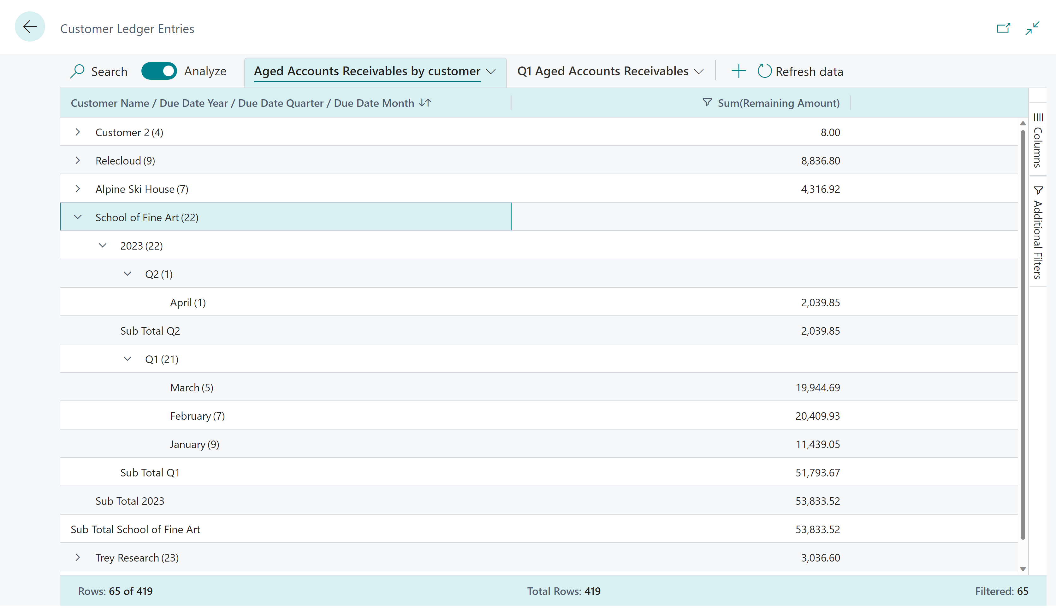
Now: self-service with Analysis Mode

Slide 6
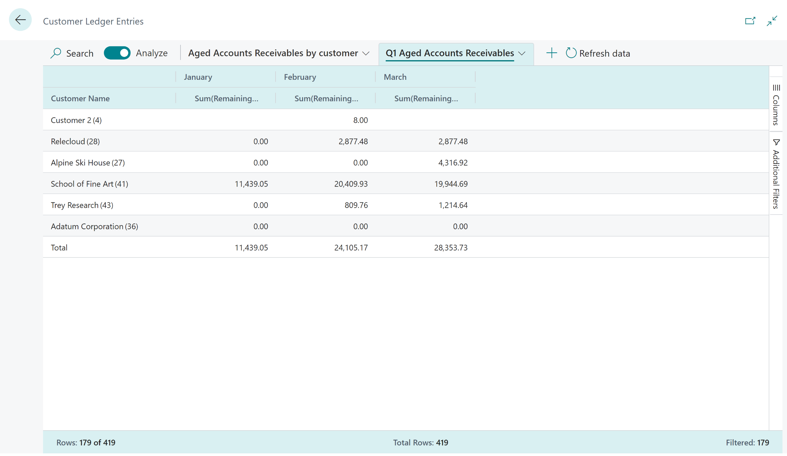
Now: self-service with Analysis Mode

Slide 7
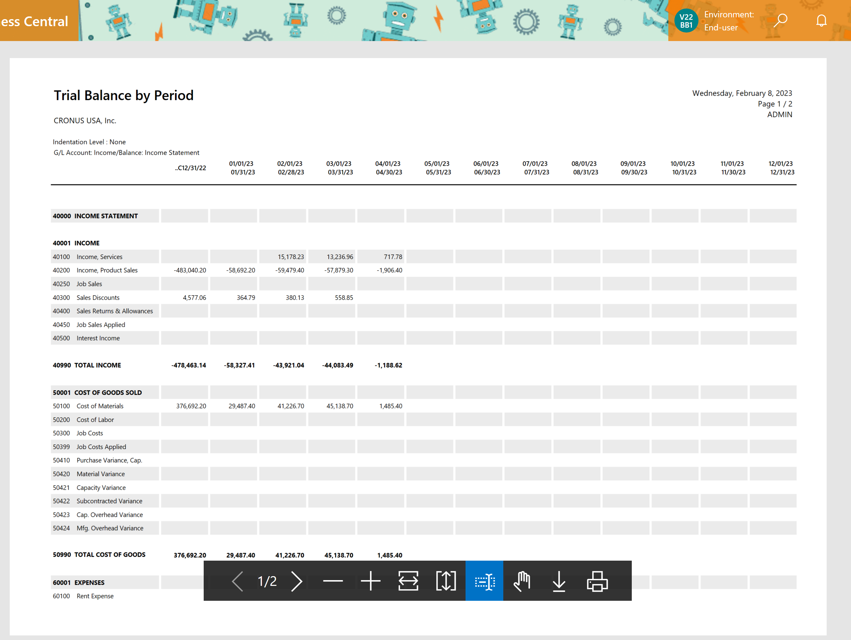
Before: Income statement as a pdf

Slide 8
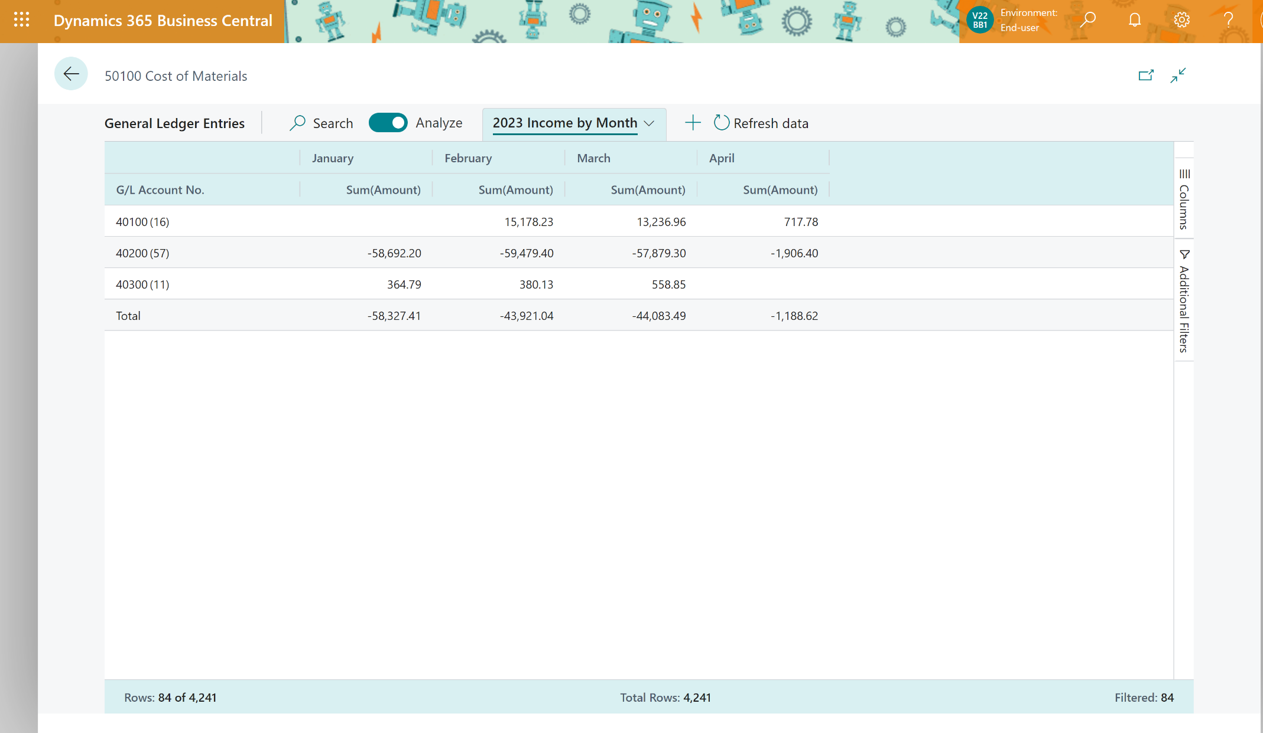
Now: Click-clickety-click income statement with Analysis mode

Slide 9
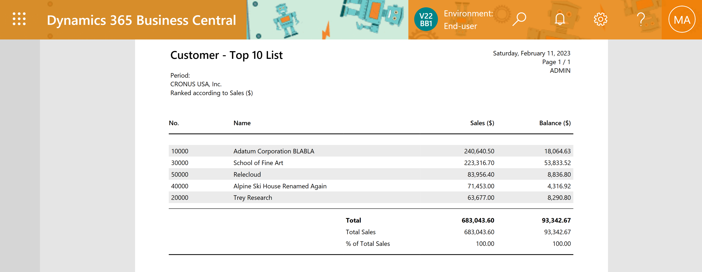
Customer top 10 list

Slide 10
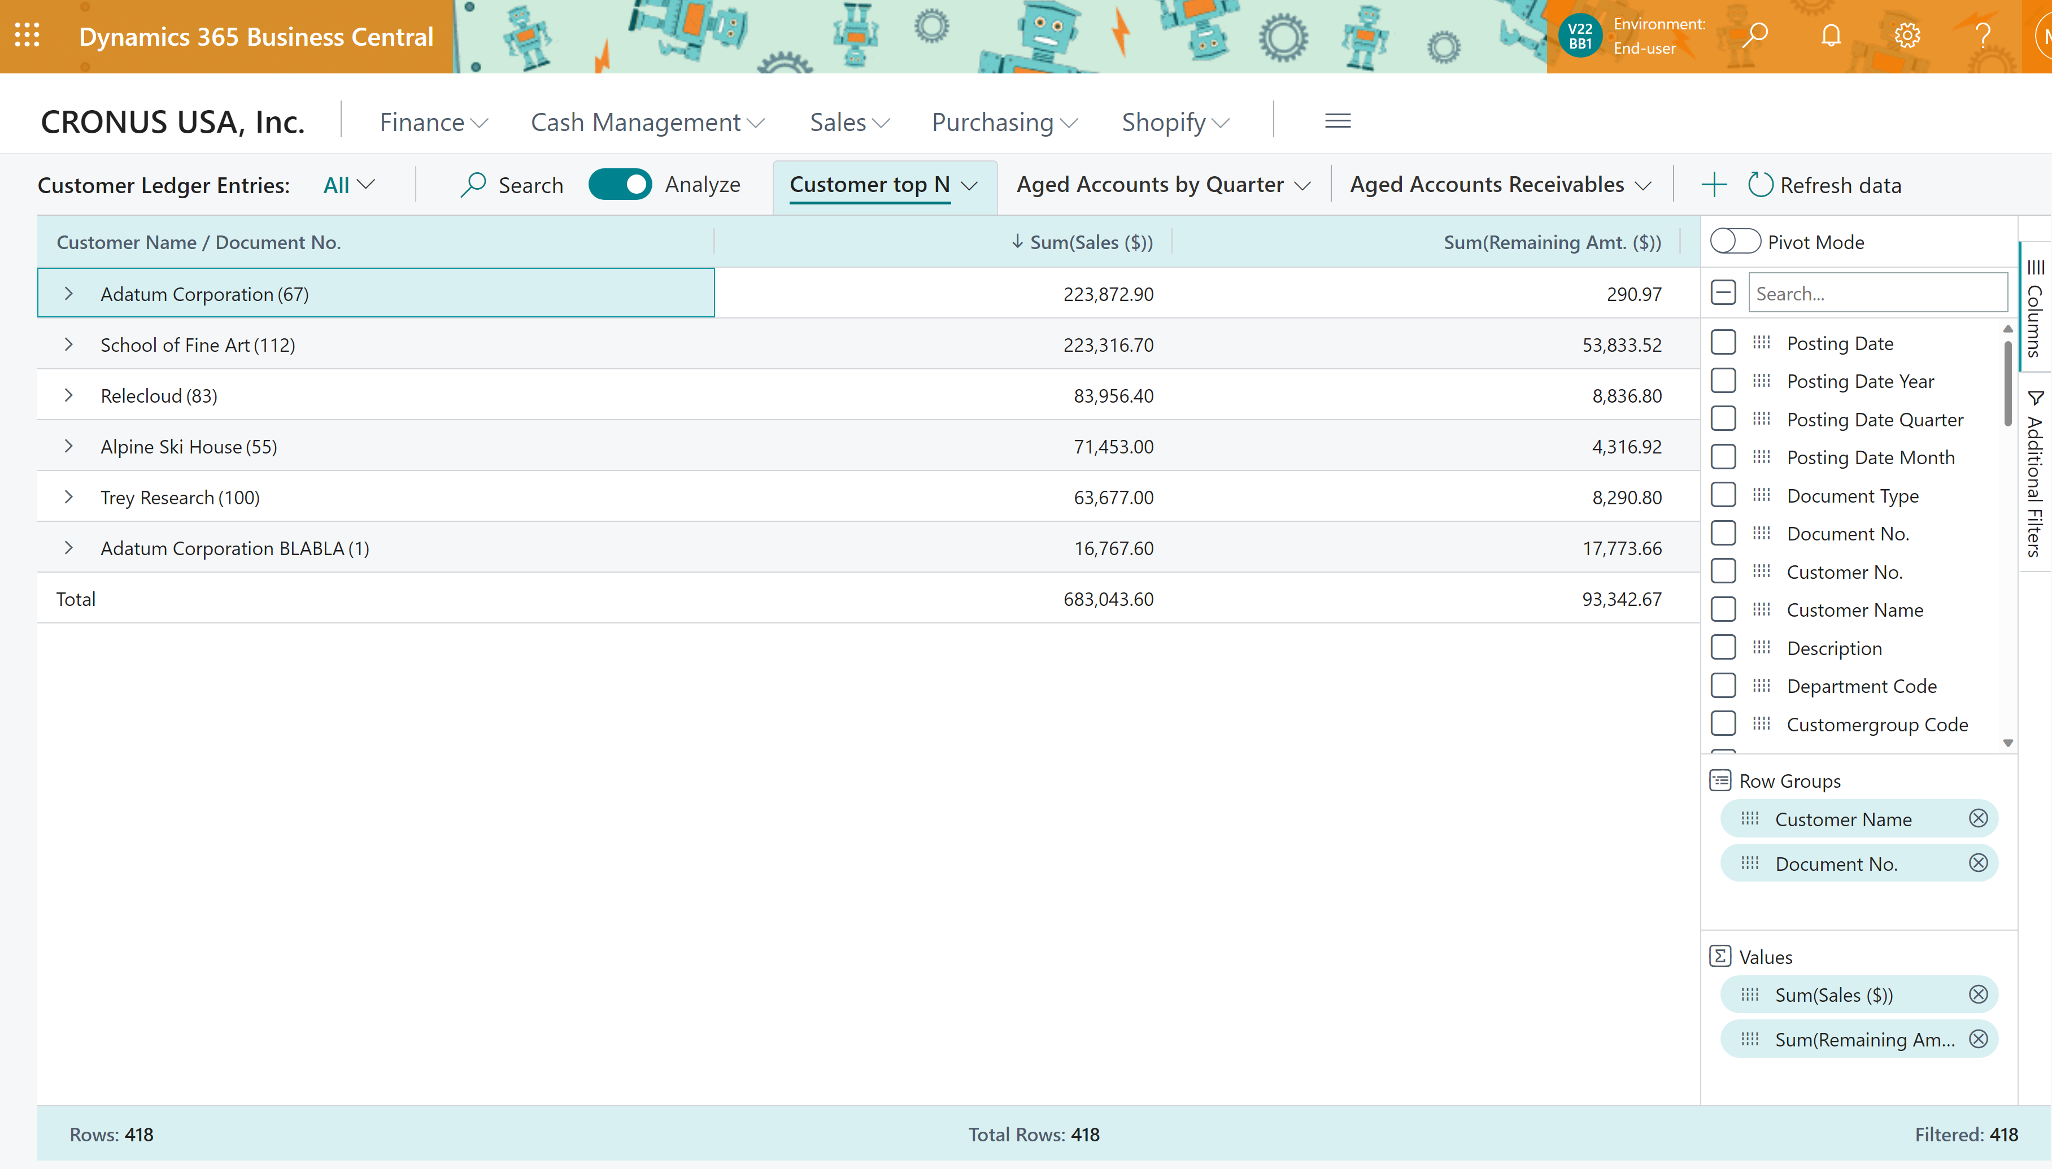
DIY Customer top N

Slide 11
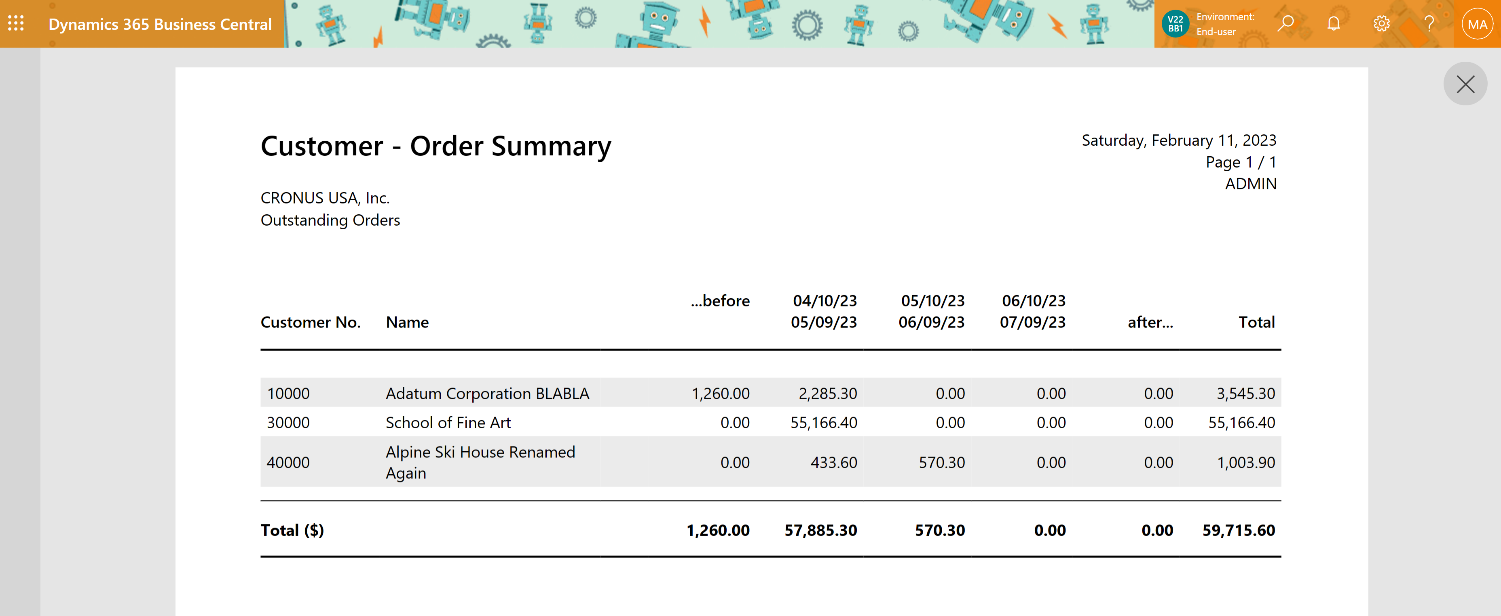
Customer - Order Summary

Slide 12
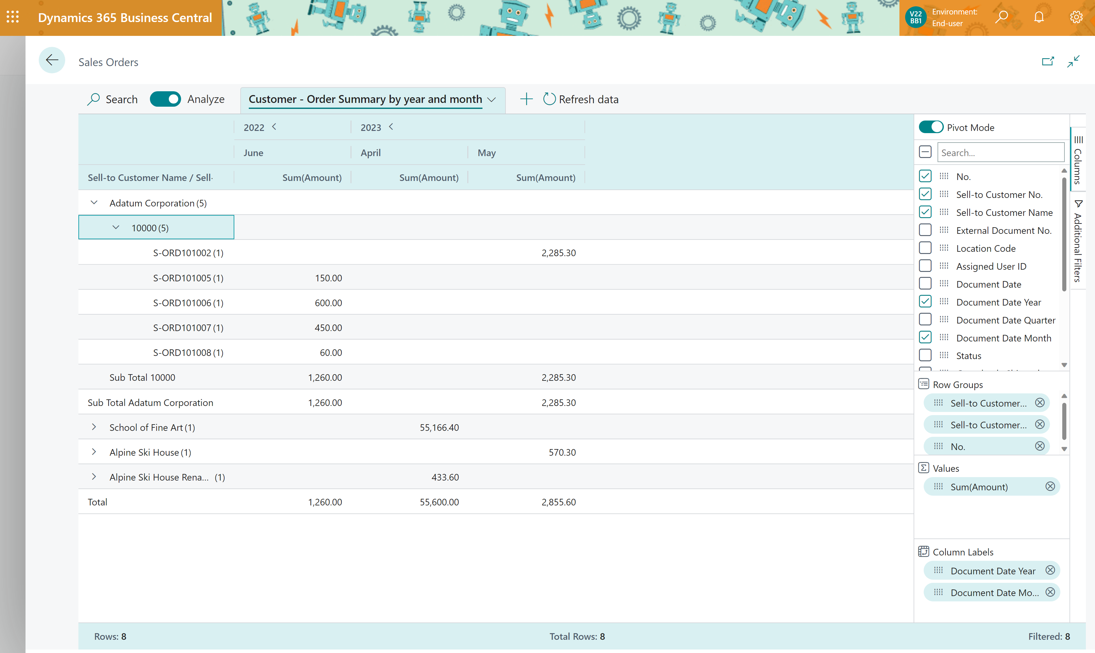
DIY Customer - Order Summary

Slide 13
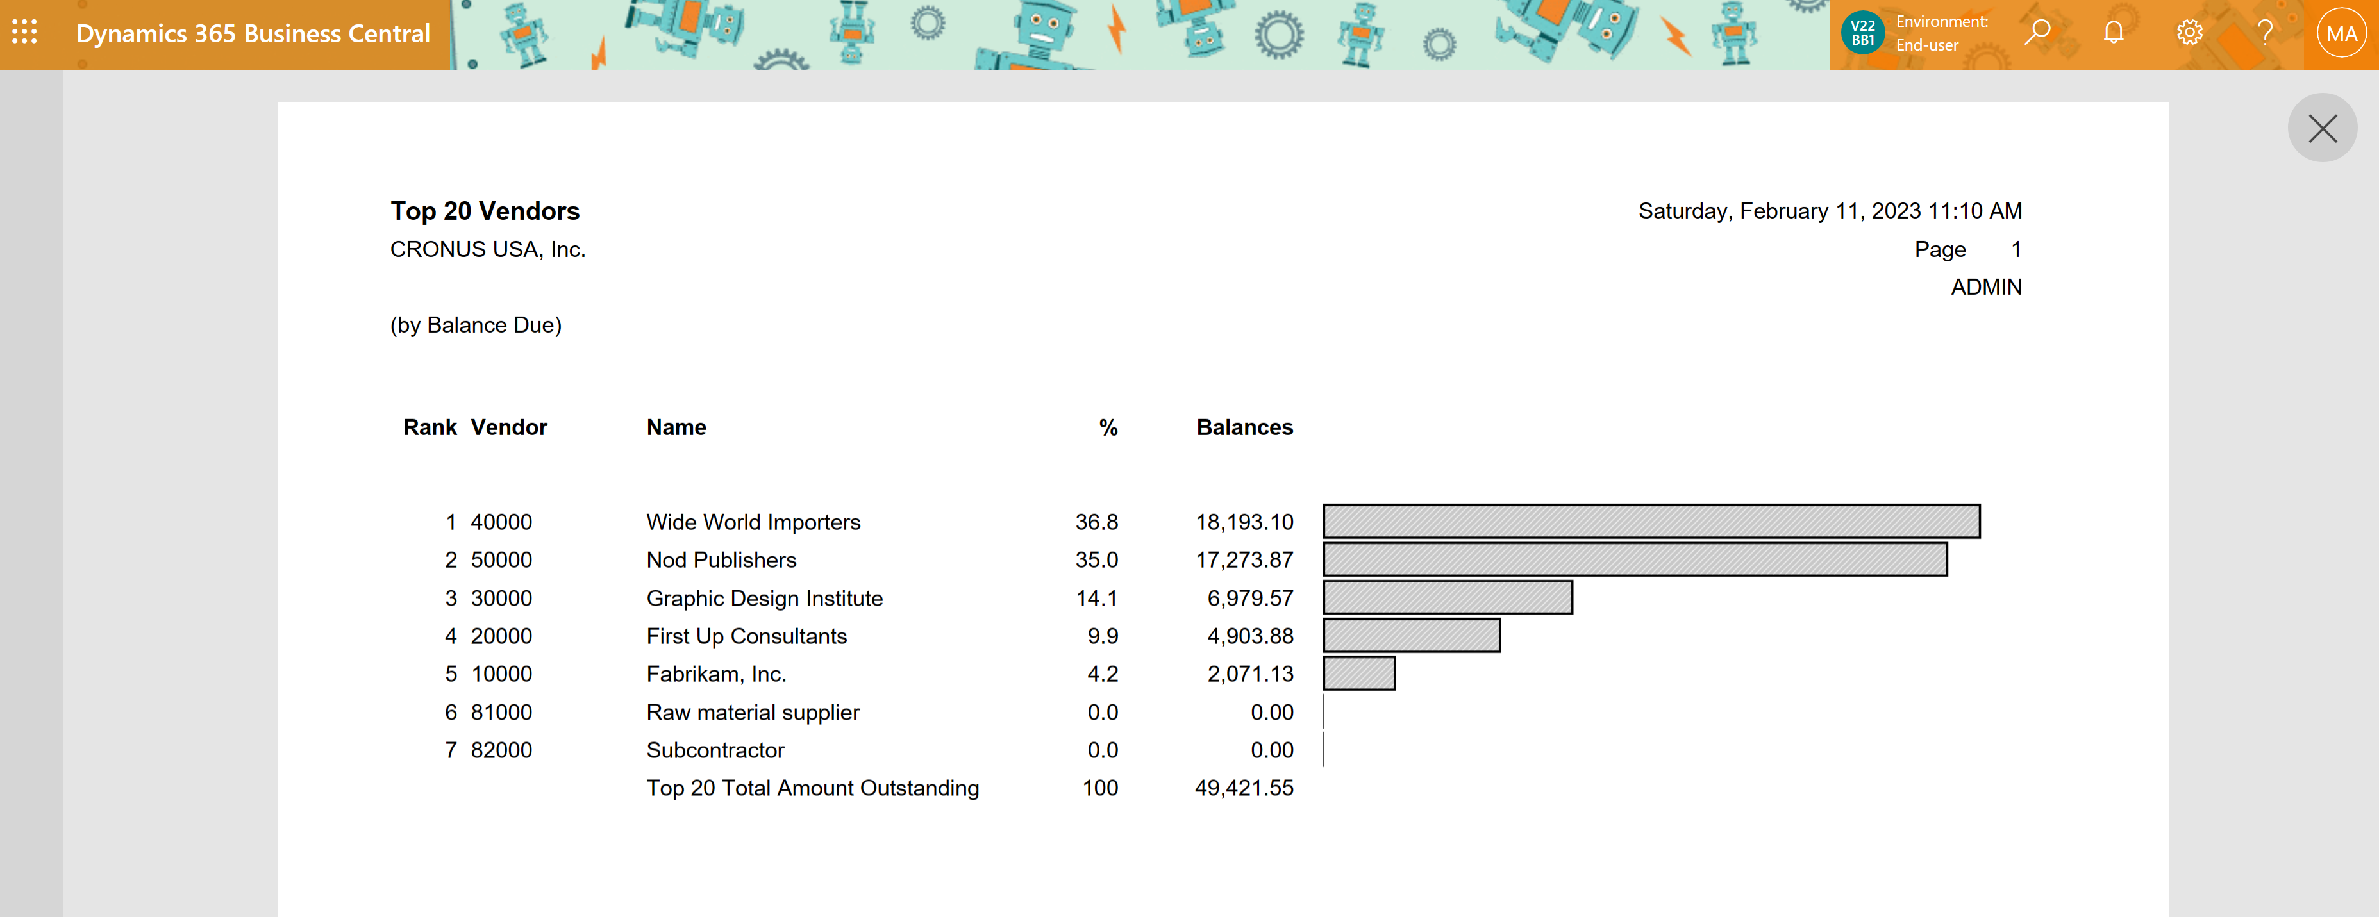
Top N vendors (by balance)

Slide 14
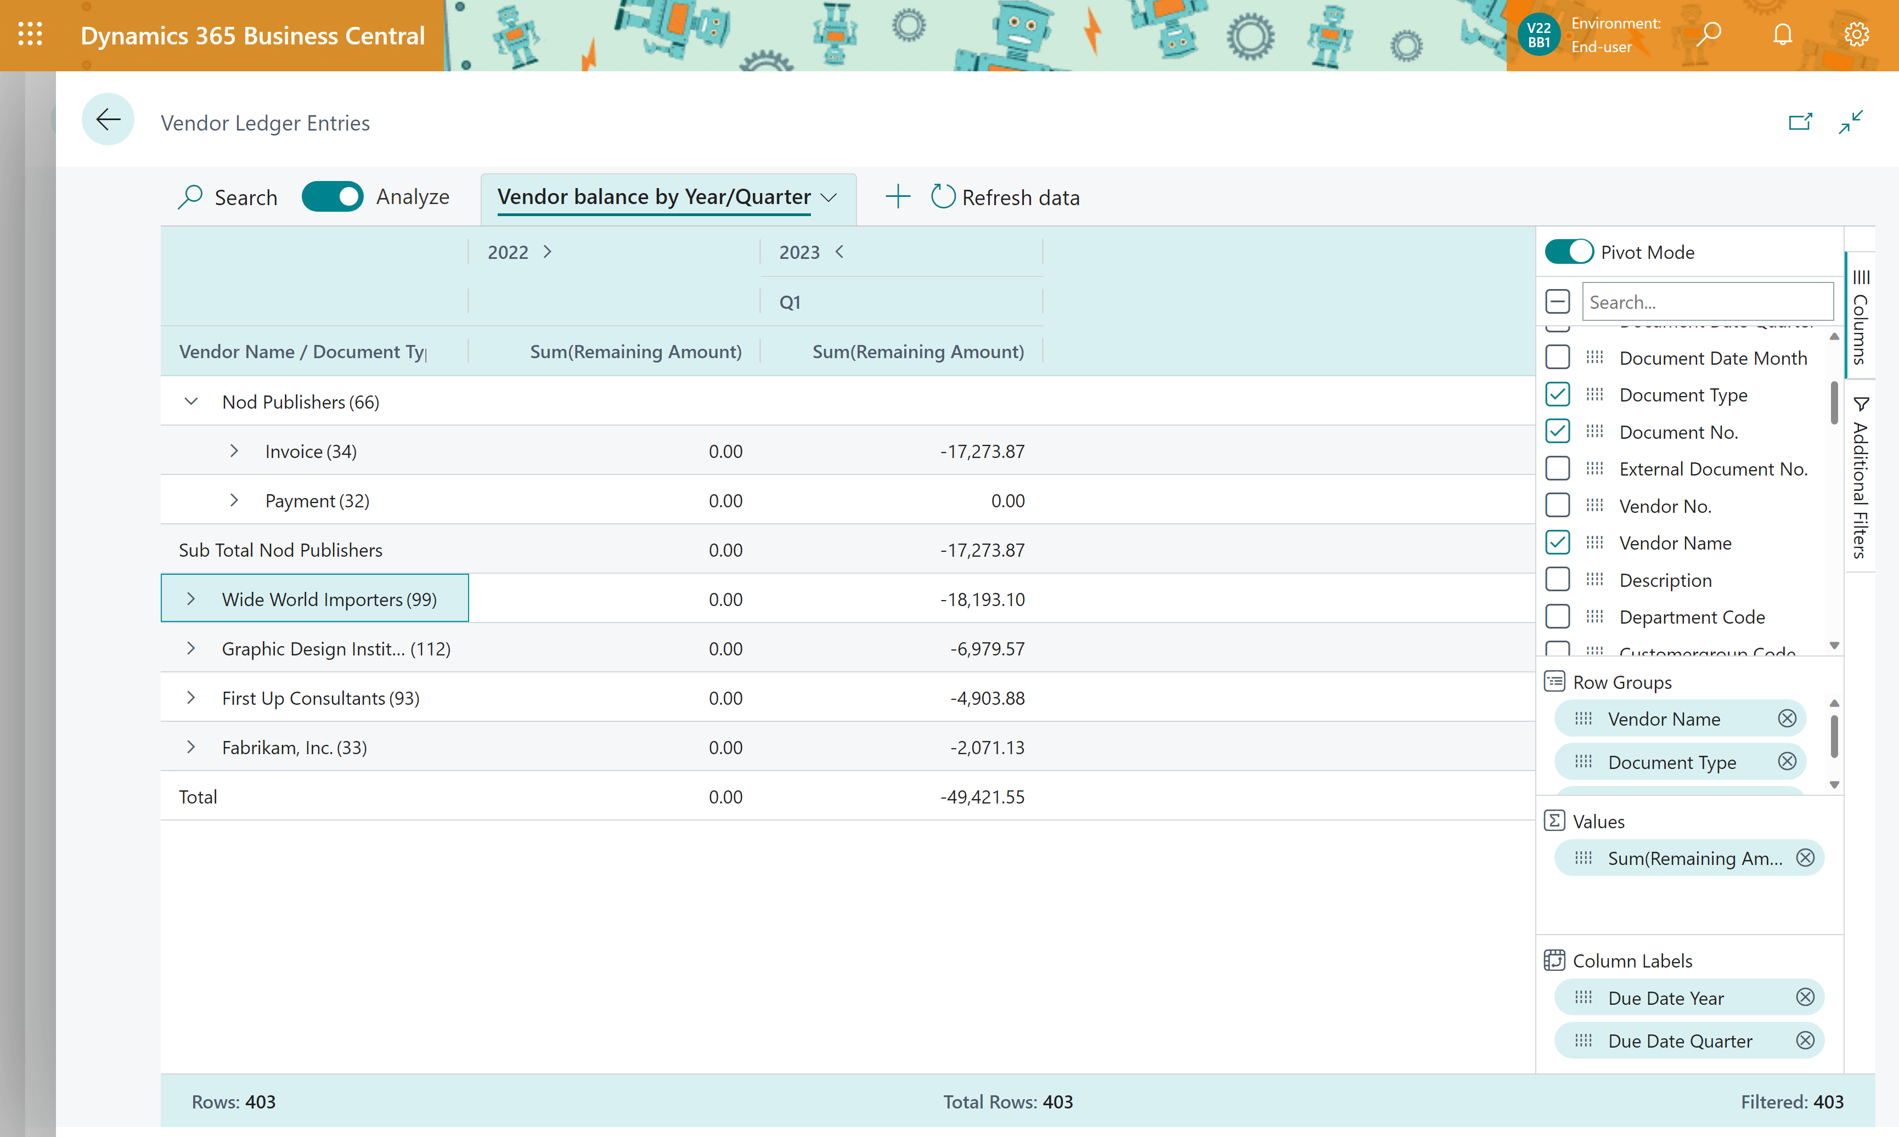
DIY Top N vendors (by balance)

Slide 15
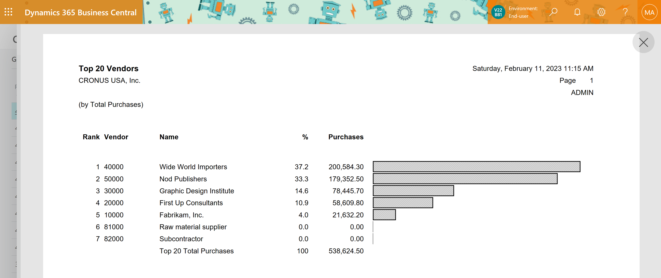
Top N vendors (by purchase)

Slide 16
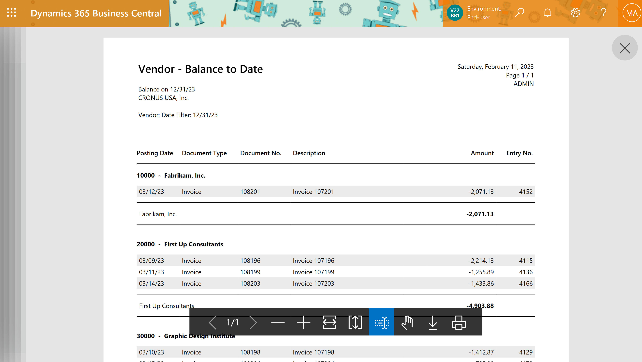
Vendor - Balance to Date

Slide 17
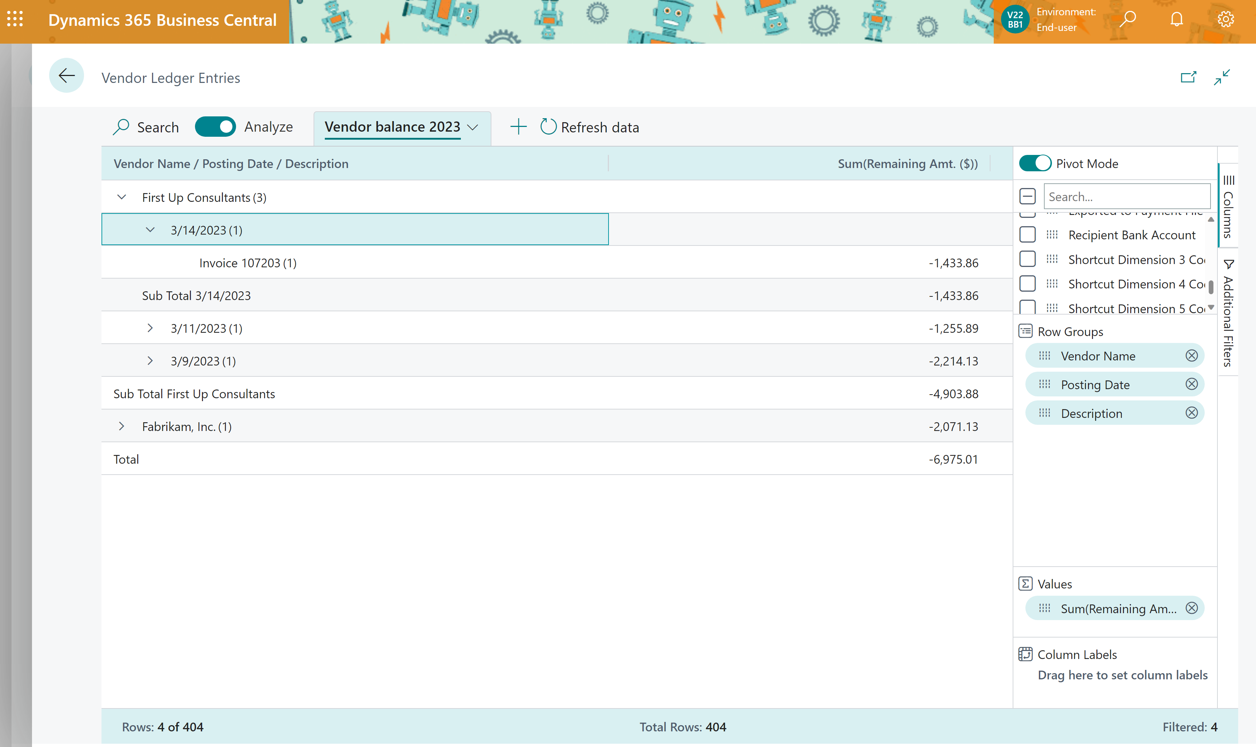
DIY Vendor - Balance to Date

Slide 18
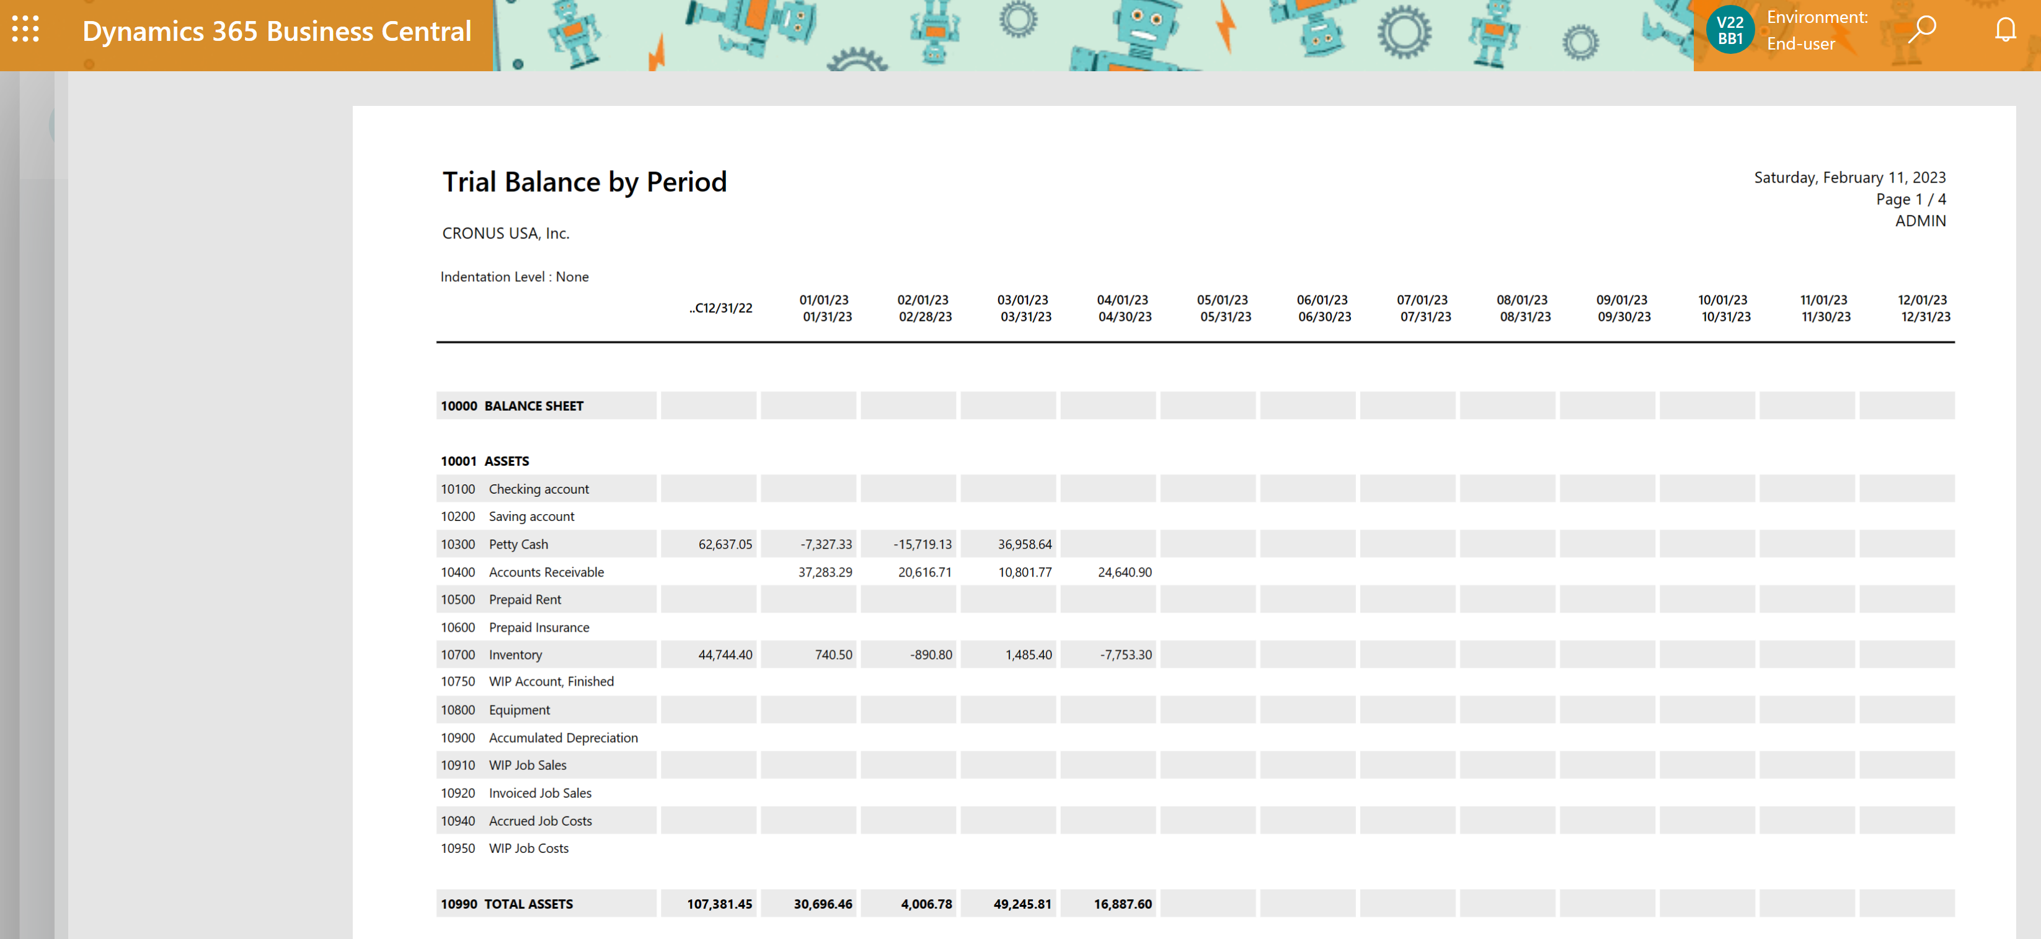
Total Assets report

Slide 19
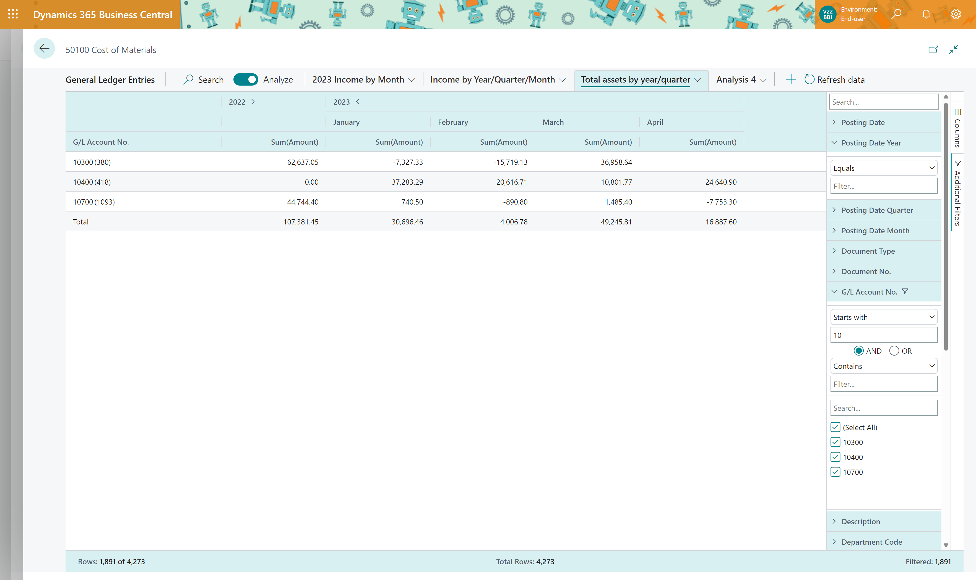
DYI Total Assets report

